Slide 1
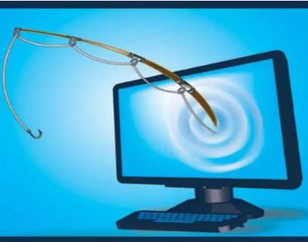
Phishing Attack
Presented By
Zahid Hasan

Slide 2
CONTENTS
1. Introduction
2. What is Phishing
3. How does phishing work?
4. What the are dangers of phishing attacks?
5.Phishing Example
6.The different flavor of phishing attack
7. Types of Phishing
8. How do I protect against phishing attacks?
9. Causes of Phishing
10. Conclusion
11. Reference

Slide 3
INTRODUCTION
A phishing attack is a type of cyber attack where perpetrators impersonate legitimate individuals or organizations to deceive victims into providing sensitive information such as usernames, passwords, credit card details, or other personal data.
The term "phishing" is a play on the word "fishing" because attackers are "fishing" for sensitive information. Phishing attacks often employ psychological manipulation tactics to trick recipients into taking actions that compromise their security. This can include creating a sense of urgency, fear, or curiosity to prompt victims to click on malicious links, download malicious attachments, or divulge confidential information.

Slide 4
WHAT IS PHISHING
Phishing is a type of cyber attack where malicious actors attempt to deceive individuals into providing sensitive information such as usernames, passwords, and financial details.
Attackers impersonate legitimate entities through electronic communication channels such as email, instant messaging, or social media.

Slide 5
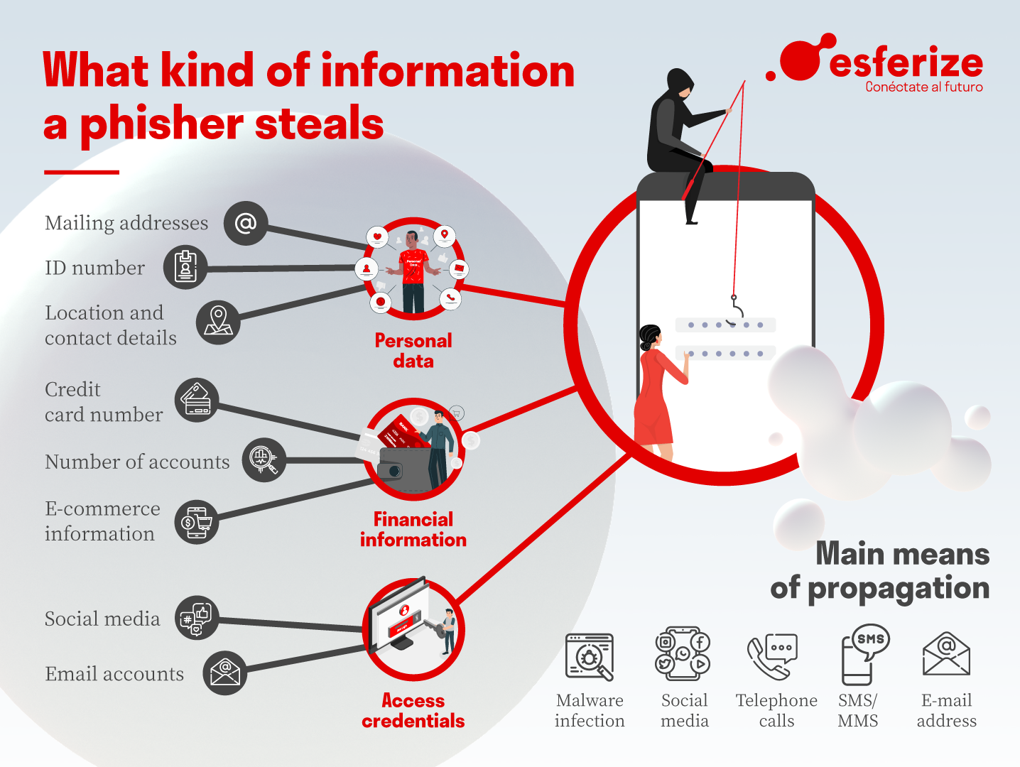
HOW DOES PHISHING WORK?

Slide 6
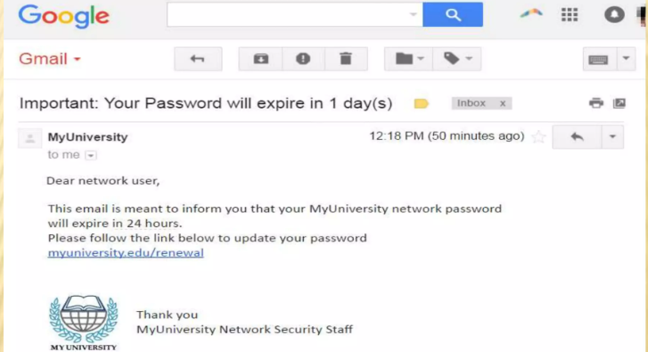
PHISHING EXAMPLE

Slide 7
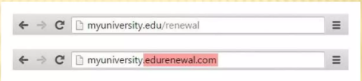
PHISHING EXAMPLES

Slide 8
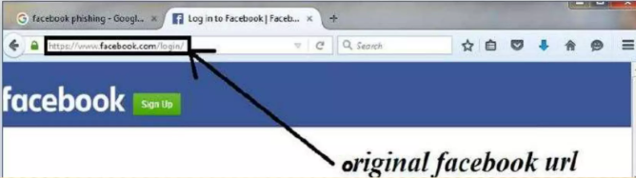
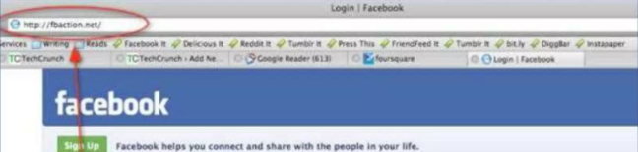
PHISHING EXAMPLES

Slide 9
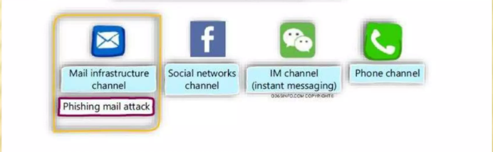
THE DIFFERENT FLAVOR OF PHISHING ATTACK

Slide 10
TYPES OF PHISHING
1. Deceptive phishing
2. Spear phishing
3. Whaling
4. Pharming

Slide 11
TYPES OF PHISHING
1. Deceptive phishing
Highly convincing email or message content, often using official logos, language, and formatting to appear legitimate.
Urgent or alarming requests for immediate action, such as updating account information or verifying credentials.
Sophisticated social engineering techniques to manipulate victims into disclosing personal or financial information.

Slide 12
TYPES OF PHISHING
2. Spear phishing
Personalized content tailored to individual recipients, including names, job titles, and other relevant details.
Use of insider knowledge or references to internal processes, projects, or colleagues to establish credibility.
Advanced social engineering techniques to manipulate victims into taking specific actions, such as clicking on malicious links or providing sensitive information.

Slide 13
TYPES OF PHISHING
3. Whaling
Highly targeted approach focusing on individuals with authority or access to critical systems and data.
Sophisticated social engineering techniques, including extensive research and reconnaissance to gather personal information and mimic communication styles.
Use of urgent or authoritative language to manipulate victims into complying with requests, such as wire transfers or confidential data disclosure.

Slide 14
TYPES OF PHISHING
4. Pharming
Invisible to Users: Pharming attacks are often invisible to users, as they are redirected to fraudulent websites without any indication of tampering or malicious activity.
Targeted and Widespread: Attackers can target specific websites or conduct widespread attacks affecting numerous users across different geographic locations.
Persistent Threat: Pharming attacks can persist over time, as long as attackers maintain control over compromised DNS servers or hosts.

Slide 15
WHAT THE ARE DANGER OF PHISHING ATTACKS
Financial Loss: Phishing attacks often aim to deceive individuals into providing sensitive financial information such as credit card details or login credentials. This information can then be used by attackers to conduct fraudulent transactions, leading to financial loss for the victim.
Identity Theft: By tricking individuals into disclosing personal information such as social security numbers, birthdates, or addresses, phishing attackers can commit identity theft. This can result in severe consequences for victims, including damage to credit scores, fraudulent accounts opened in their name, and difficulty in resolving the resulting issues.
Unauthorized Access: Phishing attacks targeting organizations may aim to gain unauthorized access to sensitive data or internal systems. Once attackers have access, they can steal proprietary information, intellectual property, or confidential customer data. This can result in significant financial and reputational damage for the organization.

Slide 16
HOW DO I PROTECT AGAINST PHISHING ATTACK?
Educate and raise awareness about phishing techniques.
Verify the authenticity of unexpected communications.
Use email filtering and authentication technologies.
Implement multi-factor authentication (MFA).
Keep software and systems updated.
Install web browser security tools and extensions.
Establish clear procedures for reporting and responding to phishing incidents.

Slide 17
CAUSES OF PHISHING
Profit motive
Ease of execution
Anonymity and difficulty in tracking perpetrators
Availability of phishing tools and resources
Exploitation of human vulnerabilities
Accessibility of personal and financial information online
Lack of robust cybersecurity measures

Slide 18
EFFECTS OF PHISHING
Financial loss
Identity theft
Compromised personal and sensitive information
Damage to reputation
Disruption of business operations
Legal and regulatory consequences
Loss of customer trust and confidence

Slide 19
CONCLUSION
In conclusion, phishing attacks represent a significant and pervasive threat in today's digital landscape. With their ability to deceive individuals and organizations into divulging sensitive information, these attacks can lead to financial loss, identity theft, reputational damage, and legal consequences. It is imperative for individuals and businesses to remain vigilant, educate themselves on phishing techniques, implement robust security measures, and foster a culture of cybersecurity awareness to effectively defend against this ever-evolving threat. By taking proactive steps to protect against phishing attacks, we can safeguard our personal and organizational assets and mitigate the risks associated with malicious online activities.

Slide 20
REFERENCE
Anti-Phishing Working Group (APWG): https://www.apwg.org/
Verizon Data Breach Investigations Report (DBIR): https://enterprise.verizon.com/resources/reports/dbir/
Symantec Internet Security Threat Report: https://www.broadcom.com/company/newsroom/press-releases
Cybersecurity and Infrastructure Security Agency (CISA): https://www.cisa.gov/
Academic Journals and Research Papers: ACM Digital Library, IEEE Xplore, Elsevier's ScienceDirect.

Slide 21


